Slide 1
Arithmetic and Logic Microoperations

Slide 2
Topics
Arithmetic
Signed and unsigned numbers
Addition and Subtraction
Logical operations
ALU: arithmetic and logic unit
Multiply
Divide
Floating Point
  notation
  add
  multiply
TU/e Processor Design 5Z032

Slide 3
Arithmetic
Where we've been:
  Performance (seconds, cycles, instructions)
  Abstractions:
  Instruction Set Architecture
  Assembly Language and Machine Language
What's up ahead:
  Implementing the Architecture
operation
a
32
ALU
result
32
b
32
TU/e Processor Design 5Z032

Slide 4
Binary numbers (1)
Bits have no inherent meaning (no semantics)
Decimal number system, e.g.:
4382 = 4x10³ + 3x10² + 8x10¹ + 2x10⁰
Can use arbitrary base g; value of digit c at position i:
c x g^{i}
Binary numbers (base 2)
  n-1 n-2 … 1 0
  a_{n-1} a_{n-2} … a₁ a₀
  2^{n-1} 2^{n-2} … 2¹ 2⁰
(a_{n-1} a_{n-2}... a₁ a₀) _{two} = a_{n-1} x 2^{n-1} + a_{n-2} x 2^{n-2} + … + a₀ x 2⁰
position
digit
weight
TU/e Processor Design 5Z032

Slide 5
Binary numbers (2)
So far numbers are unsigned
With n bits 2^{n} possible combinations
  a₀ : least significant bit (lsb)
  a_{n-1}: most significant bit (msb)
1 bit 2 bits 3 bits 4 bits decimal value
0 00 000 0000 0
1 01 001 0001 1
10 010 0010 2
11 011 0011 3
100 0100 4
101 0101 5
110 0110 6
111 0111 7
1000 8
1001 9
TU/e Processor Design 5Z032

Slide 6
Binary numbers (3)
Binary numbers (base 2)
0000 0001 0010 0011 0100 0101 0110 0111 1000 1001...
decimal: 0...2^{n}-1
Of course it gets more complicated:
- numbers are finite (overflow)
- fractions and real numbers
- negative numbers
  e.g., no MIPS subi instruction;
  however, addi can add a negative number
How do we represent negative numbers?
i.e., which bit patterns will represent which numbers?
TU/e Processor Design 5Z032

Slide 7
Conversion
Decimaal -> binair
      Divide by 2 Remainder
Hexadecimal: base 16. Octal: base 8
      1010 1011 0011 1111_{two} = ab3f_{hex}
4382
2191 0
1095 1
547 1
273 1
136 1
68 0
34 0
17 0
8 1
4 0
2 0
1 0
0 1
4382_{ten} =
1 0001 0001 1110_{two}
TU/e Processor Design 5Z032

Slide 8
Signed binary numbers
Possible representations:
Sign Magnitude: One's Complement Two's Complement
000 = +0 000 = +0 000 = +0
001 = +1 001 = +1 001 = +1
010 = +2 010 = +2 010 = +2
011 = +3 011 = +3 011 = +3
100 = -0 100 = -3 100 = -4
101 = -1 101 = -2 101 = -3
110 = -2 110 = -1 110 = -2
111 = -3 111 = -0 111 = -1
Issues: balance, number of zeros, ease of operations
Which one is best? Why?
TU/e Processor Design 5Z032

Slide 9
Two’s complement
(let’s restrict to 4 bits)
0000
1111
0001
-1
0
1
0010
1110
15
-2
2
14
1101
-3
0011
13
3
-4
12
positive
1100
4
0100
negative
11
-5
5
1011
0101
10
-6
9
6
1010
8
0110
-7
7
-8
1001
0111
1000
TU/e Processor Design 5Z032

Slide 10
Two’s complement
3+2=5
0000
1111
0001
-1
0
1
0010
1110
15
-2
2
14
1101
-3
0011
13
3
-4
12
positive
1100
4
0100
negative
11
-5
5
1011
0101
10
-6
9
6
1010
8
0110
-7
7
-8
1001
0111
1000
TU/e Processor Design 5Z032

Slide 11
Two’s complement
3+ (-5) = -2
0000
1111
0001
-1
0
1
0010
1110
15
-2
2
14
1101
-3
0011
13
3
-4
12
positive
1100
4
0100
negative
11
-5
5
1011
0101
10
-6
9
6
1010
8
0110
-7
7
-8
1001
0111
1000
TU/e Processor Design 5Z032

Slide 12
Two’s complement
3+6 = -7 !!
overflow
0000
1111
0001
-1
0
1
0010
1110
15
-2
2
14
1101
-3
0011
13
3
-4
12
positive
1100
4
0100
negative
11
-5
5
1011
0101
10
-6
9
6
1010
8
0110
-7
7
-8
1001
0111
1000
TU/e Processor Design 5Z032

Slide 13
Two’s complement
-3 + (-6) = 7 !!
underflow
0000
1111
0001
-1
0
1
0010
1110
15
-2
2
14
1101
-3
0011
13
3
-4
12
positive
1100
4
0100
negative
11
-5
5
1011
0101
10
-6
9
6
1010
8
0110
-7
7
-8
1001
0111
1000
TU/e Processor Design 5Z032

Slide 14
Two’s complement
32 bit signed numbers:
0000 0000 0000 0000 0000 0000 0000 0000_{two} = 0_{ten}
0000 0000 0000 0000 0000 0000 0000 0001_{two} = + 1_{ten}
0000 0000 0000 0000 0000 0000 0000 0010_{two} = + 2_{ten}
...
0111 1111 1111 1111 1111 1111 1111 1110_{two} = + 2,147,483,646_{ten}
0111 1111 1111 1111 1111 1111 1111 1111_{two} = + 2,147,483,647_{ten}
1000 0000 0000 0000 0000 0000 0000 0000_{two} = – 2,147,483,648_{ten}
1000 0000 0000 0000 0000 0000 0000 0001_{two} = – 2,147,483,647_{ten}
1000 0000 0000 0000 0000 0000 0000 0010_{two} = – 2,147,483,646_{ten}
...
1111 1111 1111 1111 1111 1111 1111 1101_{two} = – 3_{ten}
1111 1111 1111 1111 1111 1111 1111 1110_{two} = – 2_{ten}
1111 1111 1111 1111 1111 1111 1111 1111_{two} = – 1_{ten}
  Range [-2 ³¹ .. 2 ³¹ -1]
(a_{n-1} a_{n-2}... a₁ a₀) _{2’s-compl} = -a_{n-1} x 2^{n-1} + a_{n-2} x 2^{n-2} + … + a₀ x 2⁰ = - 2^{n} + a_{n-1} x 2^{n-1} + … + a₀ x 2⁰
maxint
minint
TU/e Processor Design 5Z032

Slide 15
Two's Complement Operations
Negating a two's complement number: invert all bits and add 1
  remember: “negate” and “invert” are quite different!
Proof:
a + a = 1111.1111b = -1 d =>
-a = a + 1
TU/e Processor Design 5Z032

Slide 16
Two's Complement Operations
Converting n bit numbers into numbers with more than n bits:
  MIPS 8 bit, 16 bit values / immediates converted to 32 bits
Copy the most significant bit (the sign bit) into the other bits
0010 -> 0000 0010
1010 -> 1111 1010
MIPS "sign extension" example instructions:
    lb load byte (signed)
    lbu load byte (unsigned)
    slti set less than immediate (signed)
    sltiu set less than immediate (unsigned)
TU/e Processor Design 5Z032

Slide 17
Addition & Subtraction
Just like in grade school (carry/borrow 1s)
0111 0111 0110
+ 0110 - 0110 - 0101
Two's complement operations easy
  subtraction using addition of negative numbers
  0110 0110
  - 0101 + 1010
Overflow (result too large for finite computer word):
  e.g., adding two n-bit numbers does not yield an n-bit number
  0111
  + 0001 note that overflow term is somewhat misleading,
  1000 it does not mean a carry “overflowed”
TU/e Processor Design 5Z032

Slide 18
Detecting Overflow
No overflow when adding a positive and a negative number
No overflow when signs are the same for subtraction
Overflow occurs when the value affects the sign:
  overflow when adding two positives yields a negative
  or, adding two negatives gives a positive
  or, subtract a negative from a positive and get a negative
  or, subtract a positive from a negative and get a positive
Consider the operations A + B, and A – B
  Can overflow occur if B is 0 ?
  Can overflow occur if A is 0 ?
TU/e Processor Design 5Z032

Slide 19
Effects of Overflow
When an exception (interrupt) occurs:
  Control jumps to predefined address for exception
  (interrupt vector)
  Interrupted address is saved for possible resumption in exception program counter (EPC); new instruction: mfc0
  (move from coprocessor0)
  Interrupt handler handles exception (part of OS).
  registers $k0 and $k1 reserved for OS
Details based on software system / language
  C ignores integer overflow; FORTRAN not
Don't always want to detect overflow
— new MIPS instructions: addu, addiu, subu
note: addiu and sltiu still sign-extends!
TU/e Processor Design 5Z032

Slide 20
Logic operations
Sometimes operations on individual bits needed:
    Logic operation C operation MIPS instruction
    Shift left logical << sll
    Shift right logical >> srl
    Bit-by-bit AND & and, andi
    Bit-by-bit OR | or, ori
and and andi can be used to turn off some bits;
or and ori turn on certain bits
Of course, AND en OR can be used for logic operations.
  Note: Language C’s logical AND (&&) and OR (||) are conditional
andi and ori perform no sign extension !
TU/e Processor Design 5Z032

Slide 21
An ALU (arithmetic logic unit)
Let's build an ALU to support the andi and ori instructions
  we'll just build a 1 bit ALU, and use 32 of them
operation
a
result
b
TU/e Processor Design 5Z032

Slide 22
Review: The Multiplexor
Selects one of the inputs to be the output, based on a control input
Lets build our ALU and use a MUX to select the
outcome for the chosen operation
S
note: we call this a 2-input mux
even though it has 3 inputs!
A
0
C
B
1
TU/e Processor Design 5Z032

Slide 23
Different Implementations
Not easy to decide the “best” way to build something
  Don't want too many inputs to a single gate
  Don’t want to have to go through too many gates
  For our purposes, ease of comprehension is important
Let's look at a 1-bit ALU for addition (= full-adder):
CarryIn
c_{out} = a b + a c_{in} + b c_{in}
sum = a xor b xor c_{in}
a
+
Sum
b
CarryOut
How could we build a 1-bit ALU for add, and, and or?
How could we build a 32-bit ALU?
TU/e Processor Design 5Z032

Slide 24
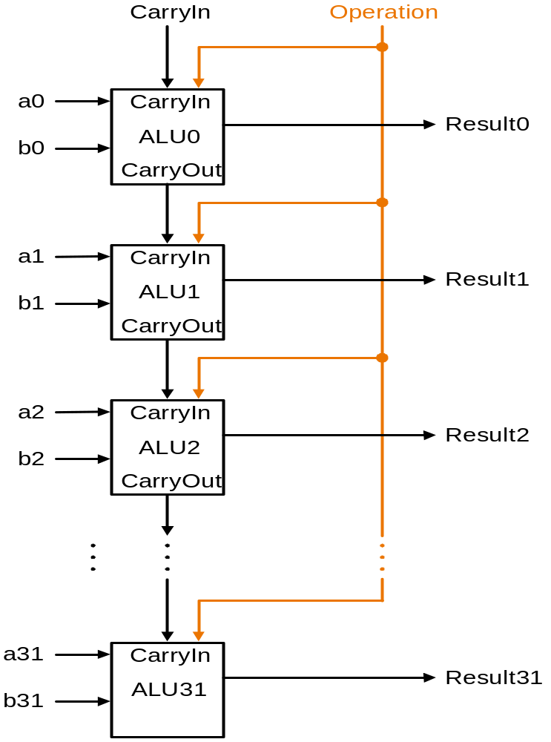
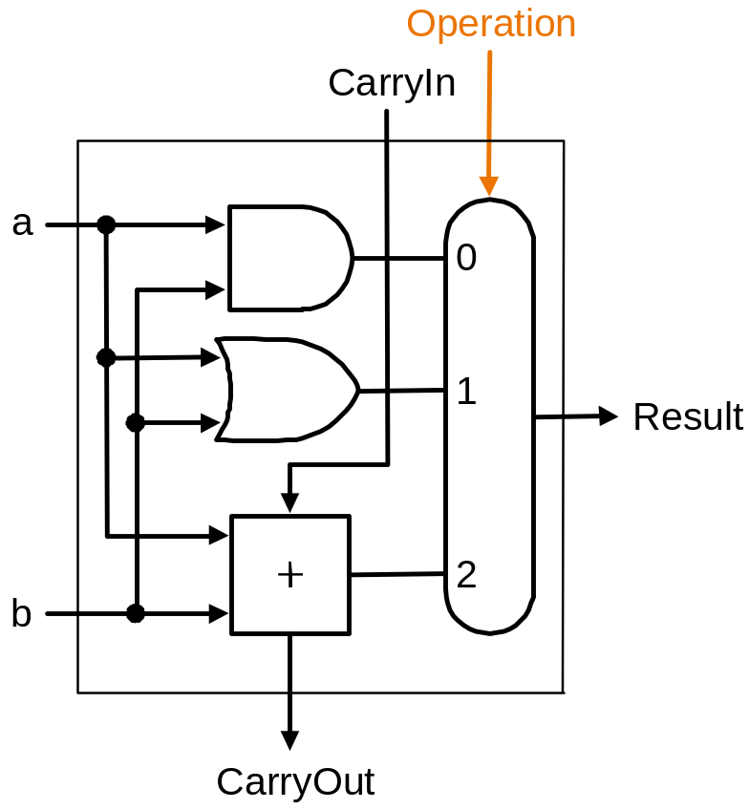
Building a 32 bit ALU
TU/e Processor Design 5Z032

Slide 25
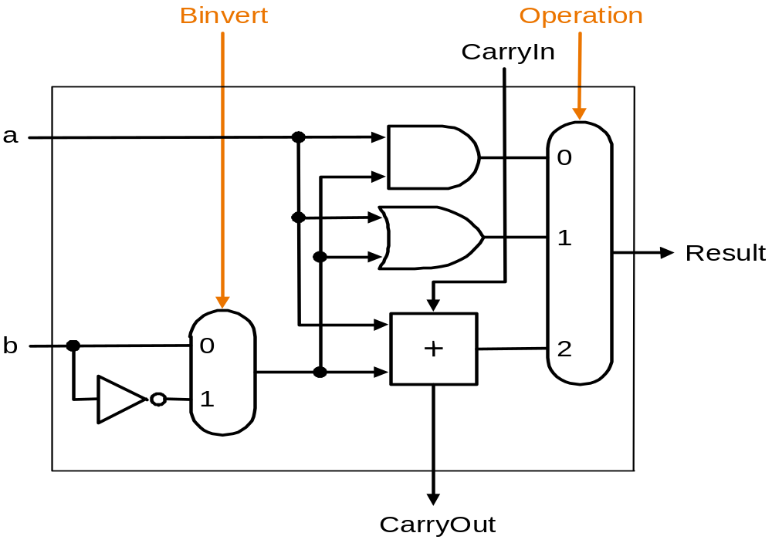
What about subtraction (a – b) ?
Two's complement approach: just negate b and add
How do we negate?
A very clever solution:
TU/e Processor Design 5Z032

Slide 26
Tailoring the ALU to the MIPS
Need to support the set-on-less-than instruction (slt)
  remember: slt rd,rs,rt is an arithmetic instruction
  produces a 1 if rs < rt and 0 otherwise
  use subtraction: (a-b) < 0 implies a < b
Need to support test for equality
  beq $t5, $t6, label
  jump to label if $t5 = $t6
  use subtraction: (a-b) = 0 implies a = b
TU/e Processor Design 5Z032

Slide 27
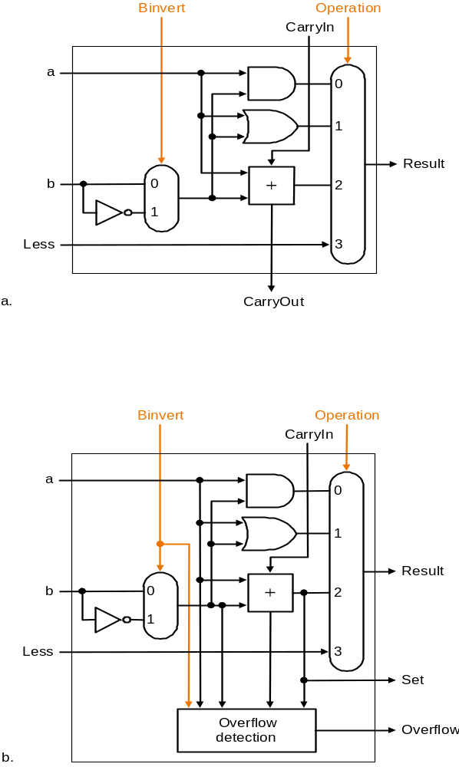
Supporting 'slt'
Can we figure out the idea?
(fig. 4.17 2nd ed.)
bits 0-30
bit 31

Slide 28
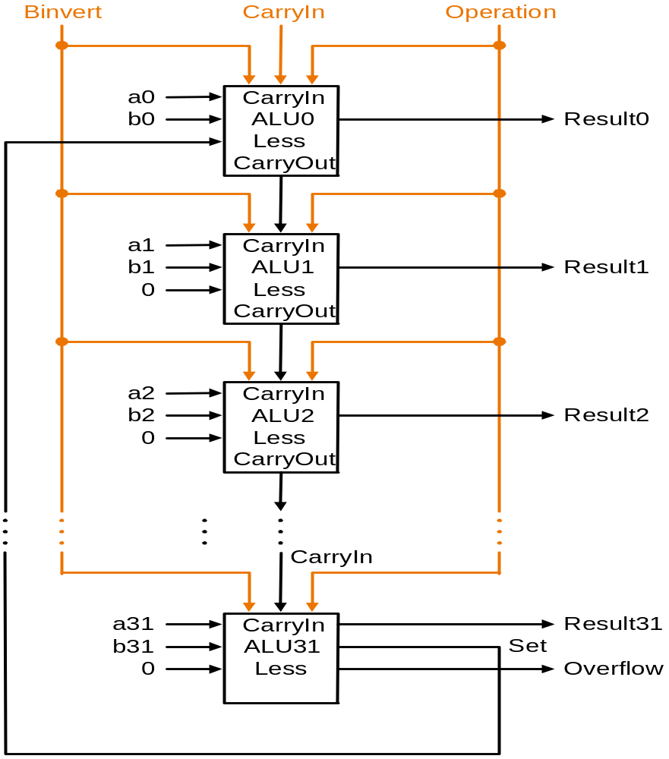
Supporting the ‘slt’ operation
TU/e Processor Design 5Z032

Slide 29
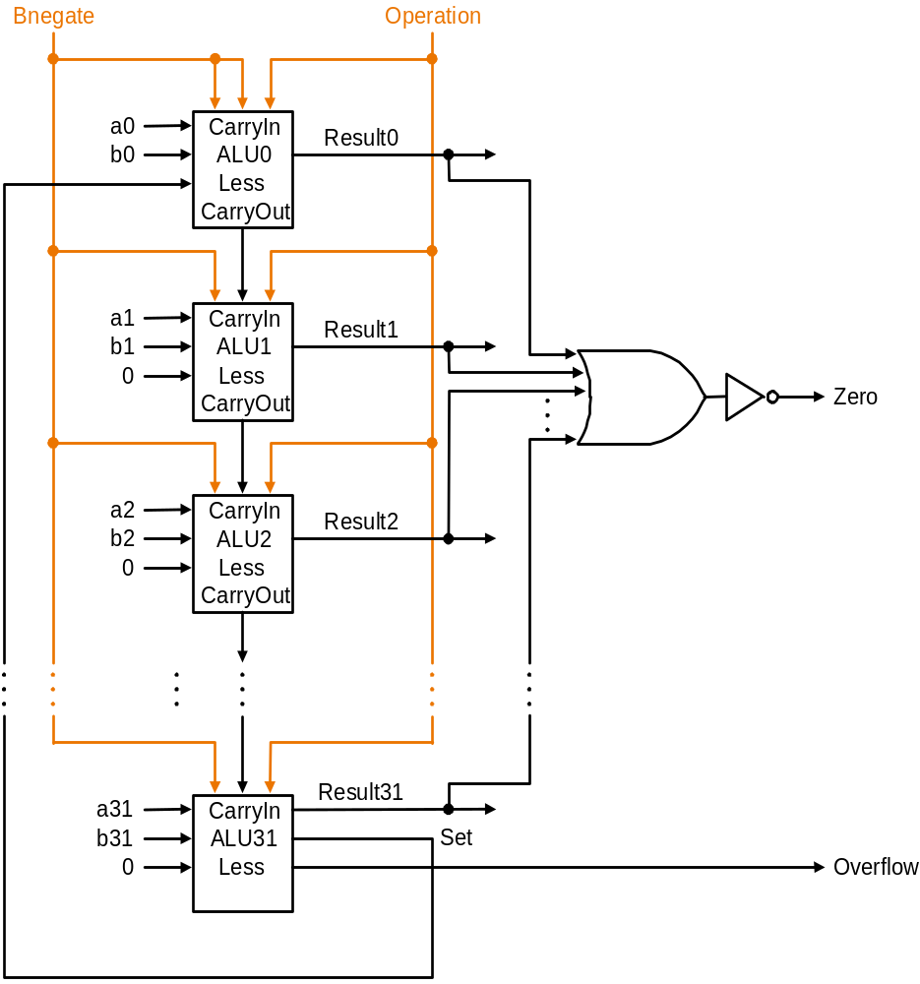
Test for equality
a-b = 0 ⇔a=b
Notice control lines:
000 = and
001 = or
010 = add
110 = subtract
111 = slt
Note: signal Zero is a 1 when the
result is zero!
The Zero output is always calculated
TU/e Processor Design 5Z032

Slide 30
ALU symbol
operation
32
a
zero
ALU
32
result
overflow
32
b
carry-out
TU/e Processor Design 5Z032

Slide 31
Conclusions
We can build an ALU to support the MIPS instruction set
  key idea: use multiplexor to select the output we want
  we can efficiently perform subtraction using two’s complement
  we can replicate a 1-bit ALU to produce a 32-bit ALU
Important points about hardware
  all of the gates are always working
    not efficient from energy perspective !!
  the speed of a gate is affected by the number of connected outputs it has to drive (so-called Fan-Out)
  the speed of a circuit is affected by the number of gates in series
  (on the “critical path” or the “deepest level of logic”)
    Unit of measure: FO4 = inverter with Fan-Out of 4
    P4 (heavily superpipelined) has about 15 FO4 critical path
TU/e Processor Design 5Z032

Slide 32
Problem: Ripple carry adder is slow
Is a 32-bit ALU as fast as a 1-bit ALU?
Is there more than one way to do addition?
  Two extremes: ripple carry and sum-of-products
  How many logic layers do we need for these two extremes?
Can you see the ripple? How could you get rid of it?
c₁ = b₀c₀ + a₀c₀ + a₀b₀
c₂ = b₁c₁ + a₁c₁ + a₁b₁ c₂ = (..subst c₁..)
c₃ = b₂c₂ + a₂c₂ + a₂b₂ c₃ =
c₄ = b₃c₃ + a₃c₃ + a₃b₃ c₄ =
Not feasible! Why not?
TU/e Processor Design 5Z032

Slide 33
Carry-lookahead adder (1)
An approach in-between our two extremes
Motivation:
  If we didn't know the value of carry-in, what could we do?
  When would we always generate a carry? g_{i} = a_{i} b_{i}
  When would we propagate the carry? p_{i} = a_{i} + b_{i}
Cin
a
b
Cout = Gi + Pi Cin
Cout
TU/e Processor Design 5Z032

Slide 34
Carry-lookahead adder (2)
Did we get rid of the ripple?
c₁ = g₀ + p₀c₀
c₂ = g₁ + p₁c₁ c₂ = g₁ + p₁(g₀ + p₀c₀)
c₃ = g₂ + p₂c₂ c₃ =
c₄ = g₃ + p₃c₃ c₄ =
a0
Cin
4
Result0-3
Feasible ?
b0
a1
b1
ALU
a2
b2
P0
a3
G0
b3
P0 = p₀.p₁.p₂.p₃
G0= g₃+(p₃.g₂)+(p₃.p₂.g₁)+(p₃.p₂.p₁.g₀)
TU/e Processor Design 5Z032

Slide 35
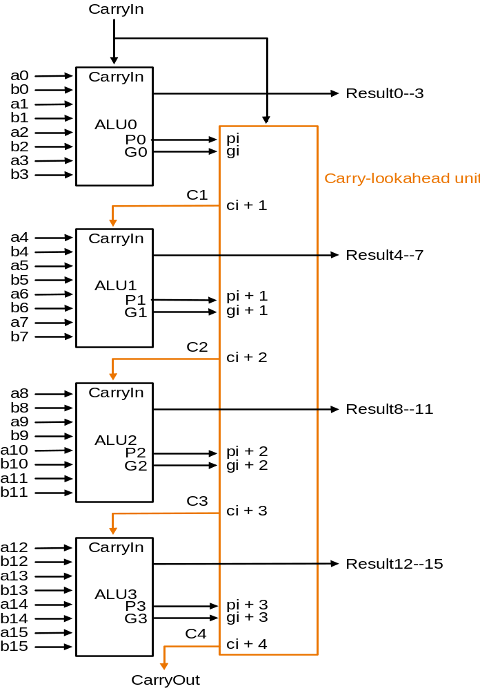
Carry-lookahead adder (3)
Use principle to build bigger adders
Can’t build a 16 bit adder this way... (too big)
Could use ripple carry of 4-bit CLA adders
Better: use the CLA principle again!
TU/e Processor Design 5Z032

Slide 36
Multiplication (1)
More complicated than addition
  accomplished via shifting and addition
More time and more area
Let's look at 3 versions based on gradeschool algorithm
0010 (multiplicand)
__*_1011 (multiplier)
Negative numbers: convert and multiply
  there are better techniques, we won’t look at them now
TU/e Processor Design 5Z032

Slide 37
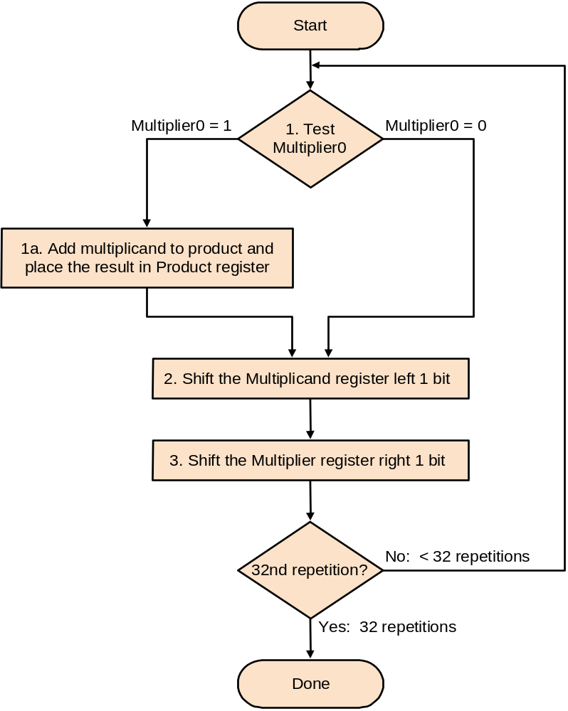
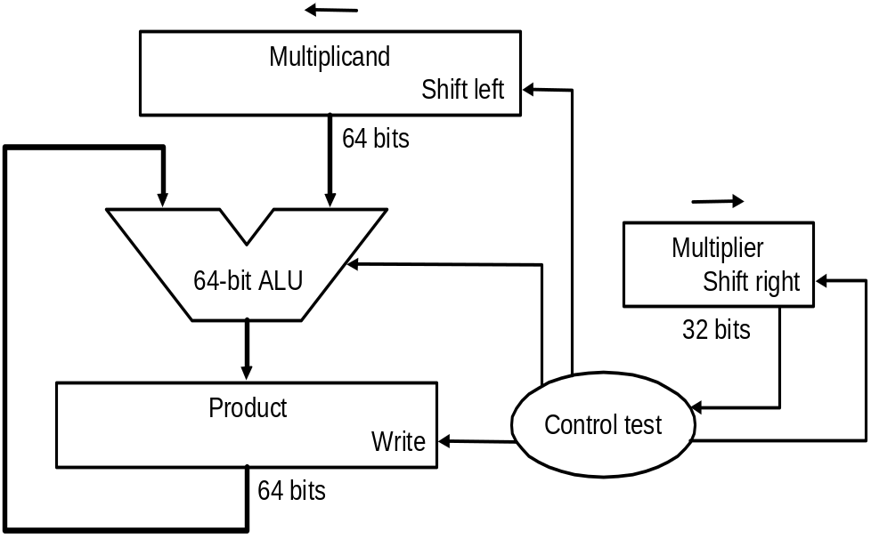
Multiplication (2)
First implementation
Product initialized to 0
TU/e Processor Design 5Z032

Slide 38
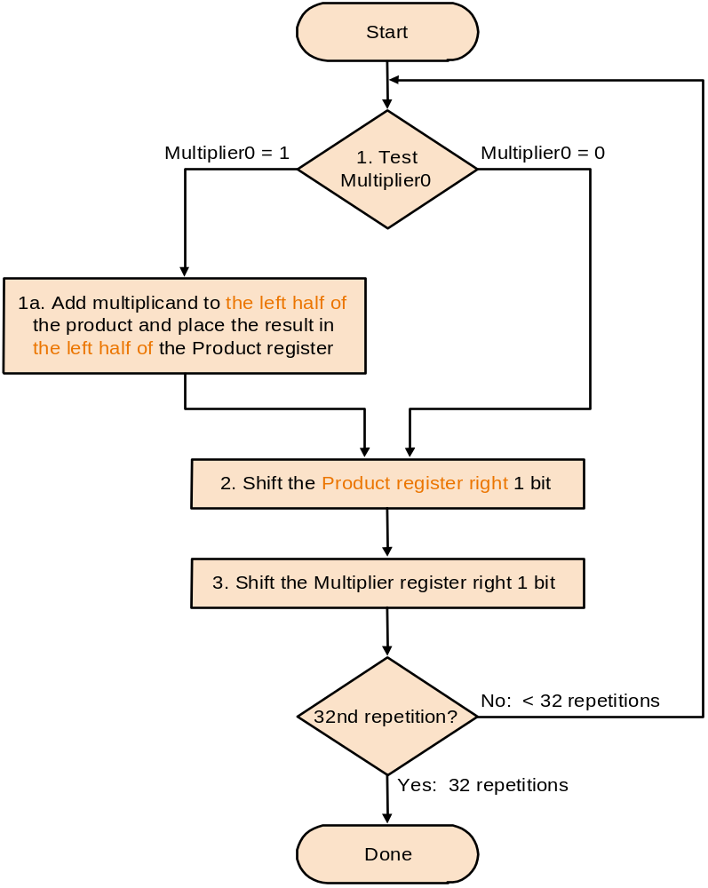
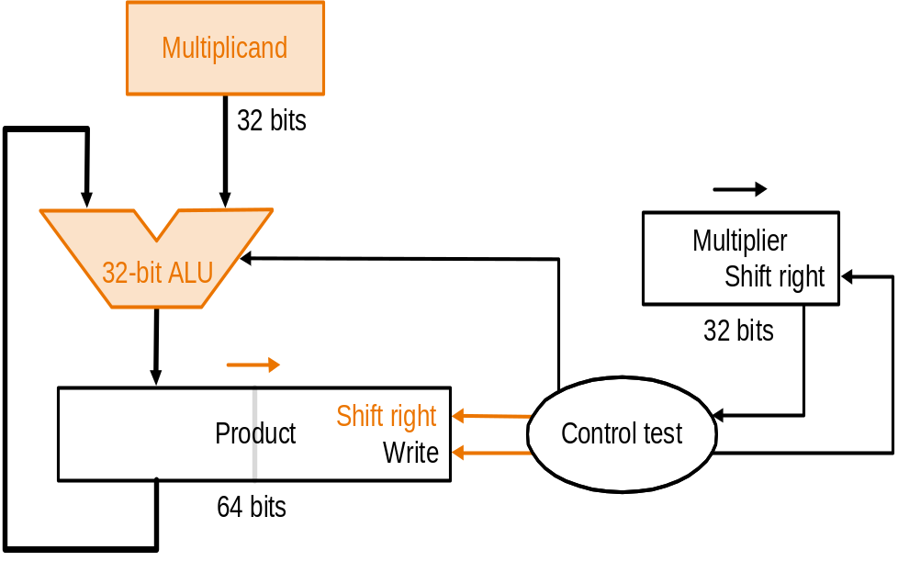
Multiplication (3)
Second version
TU/e Processor Design 5Z032

Slide 39
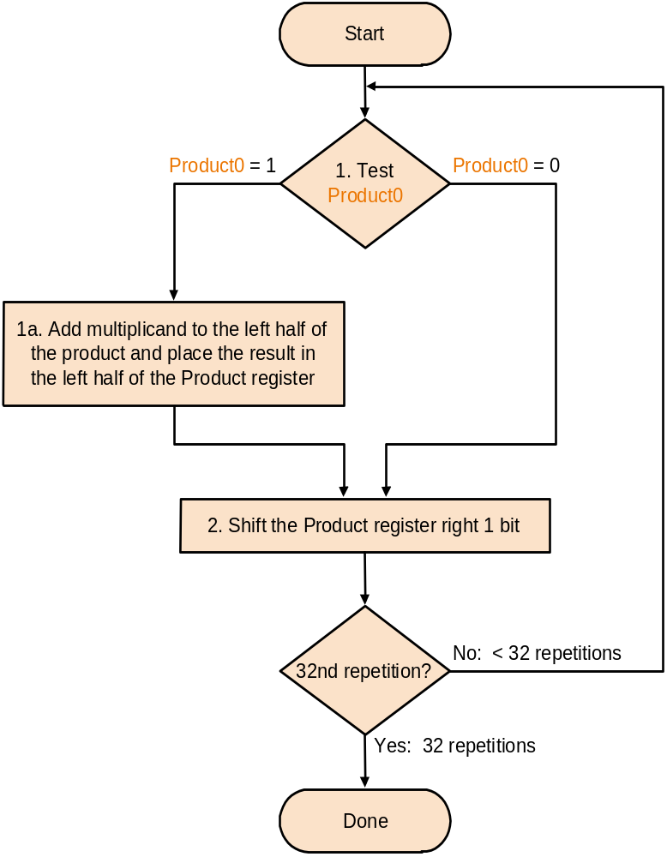
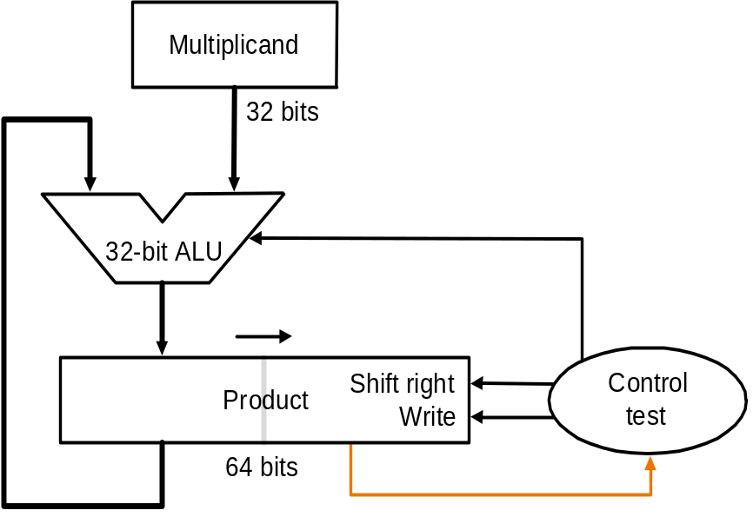
Multiplication (4)
Final version
Product initialized with multiplier
TU/e Processor Design 5Z032

Slide 40
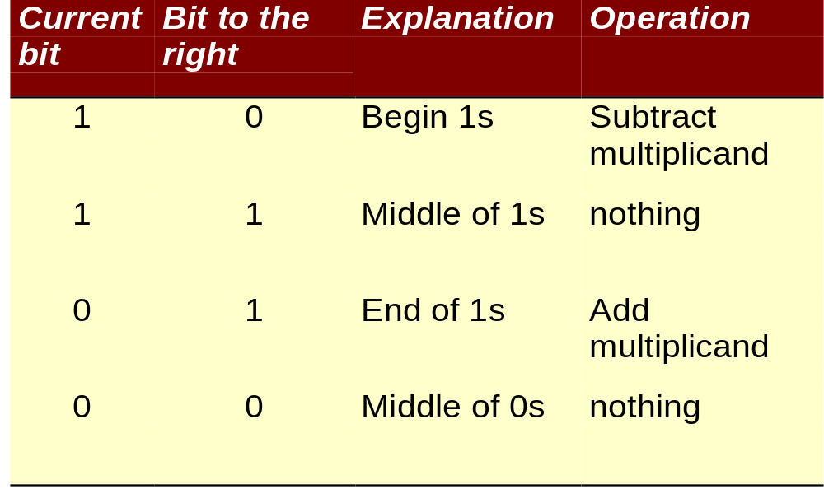
Fast multiply: Booth’s Algorithm
Exploit the fact that: 011111 = 100000 - 1
Therefore we can replace multiplier, e.g.:
0001111100 = 0010000000 - 100
Rules:
TU/e Processor Design 5Z032

Slide 41
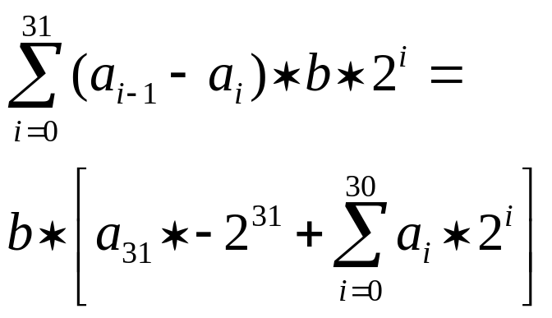
Booth’s Algorithm (2)
Booth’s algorithm works for signed 2’s complement as well (without any modification)
Proof: let’s multiply b * a
(a_{i-1} - a_{i} ) indicates what to do:
0 : do nothing
+1: add b
-1 : subtract
We get b*a =
This is exactly what we need !
TU/e Processor Design 5Z032

Slide 42
Division
Similar to multiplication: repeated subtract
TU/e Processor Design 5Z032

Slide 43
Divide (1)
Well known algorithm:
Dividend
Divisor 1000/1001010\1001 Quotient
-1000
10
101
1010
-1000
10 Remainder
TU/e Processor Design 5Z032

Slide 44
Division (2)
Start
1. Substract the Divisor register from the
Remainder register and place the
result in the Remainder register
Implementation:
Test Remainder
>= 0
< 0
2.a Shift the Quotient register
to the left, setting the
rightmost bit to 1
2.b Restore the original value by
adding the Divisor register. Also,
shift a 1 into the Quotient register
Divisor
Shift right
Shift Divisor Register right 1 bit
6
4
b
i
t
s
Quotient
33rd repetition?
no
6
4
-
b
i
t
A
L
U
Shift left
3
2
b
i
t
s
Remainder
yes
W
r
i
t
e
C
o
n
t
r
o
l
t
e
s
t
6
4
b
i
t
s
Done
TU/e Processor Design 5Z032

Slide 45
Multiply / Divide in MIPS
MIPS provides a separate pair of 32-bit registers for the result of a multiply and divide: Hi and Lo
mult $s2,$s3 # Hi,Lo = $s2 * $s3
div $s2,$s3 # Hi,Lo = $s2 mod $s3, $s2 / $s3
Copy result to general purpose register
mfhi $s1 # $s1 = Hi
mflo $s1 # $s1 = Lo
There are also unsigned variants of mult and div:
multu and divu
TU/e Processor Design 5Z032

Slide 46
Shift instructions
sll
srl
sra
Why not ‘sla’ instruction ?
Shift: a quick way to multiply and divide with power of 2 (strength reduction). Is this always allowed?
TU/e Processor Design 5Z032

